Slide 1

An IOT based framework for Statistical Analysis and Screening of Covid-19
PRIYANKA WALEKAR 19204008
APOORVA GADKARI 18104043
PRATIK GHOLAP 18104070
PROJECT GUIDE
Dr. Uttam Kolekar
Co-Guide
Prof. Sonal Jain
Notes:
1

Slide 2
Contents
Abstract
Introduction
Problem Identified
Solutions Proposed
Objective
Scope
Functionality
Technology Stack
State Diagram/Workflow
Conclusion
References
Notes:
2

Slide 3
1. Abstract
One of the most Terrifying outbreaks in recent times has been the outbreak of COVID-19. The extent of this disease can be understood by the fatality rate of this disease." precaution is better than cure" is a quote that everyone has heard at least once in their lifetime and is prevalent in the case of preventing the spread of coronavirus. Also Many countries are hiring or staying at home Blockade guidelines to control its spread. However, you can stay at home longer Causes adverse effects such as economic crisis, unemployment, food shortages and mental health problems Personal health problems There must be a question in mind how we can take extra precautions from Covid? Simple answer is following the rules given by government and continuously monitoring the factors which indicates the symptoms. This project is basically of designing an İOT framework which will be having a temperature sensor LM35 for check body temperature, pulse sensor to detect pulse rate and a SpO2 for oxygen rate detection.
A low-power wireless respiratory monitoring system with cough detection is proposed to detect various parameters that are required for the overall detection of this disease. Further, this data via an Arduino will be processed on cloud where Support Vector Machine algorithm will be performed and send the diseases prediction on the application as a conclusion. The proposed system will always used when person comes outside from house as a precaution and it can be used for actual patient monitoring and thus can be used for effective analysis and detection of this disease.
Notes:
3

Slide 4
2. Introduction
Problems Identified:
Testing results take time
Some tests are not that accurate
It is not possible that everyone has taken the vaccine
II. Proposed Solution:
The goal of this project is to create an IoT framework that can be used to measure parameters such as blood pressure, pulse rate, cough detection, and oxygen rate. This data will then be sent to a cloud where it will be analyzed. The output of the ML model, which is based on the SVM Algorithm on the cloud, will be displayed on the GUI of the Mobile Application on the individual’s phone. This will provide us with a prediction result so that the person can take the necessary actions in a timely manner. Aside from that, in order to aid in the study of other researchers, this project is expected to generate this data and place it on a website where geeks can obtain the data in the required format.
Notes:
4

Slide 5
3. Objectives
To measure Oxygen Rate, Pulse Rate, Cough and Body Temperature using Framework.
Collect the measured data and performing SVM Algorithm on Cloud to predict the diseases.
Display the predicted output on the Android Application also get some basic detail to complete the sort of data which can be used further for studying.
Display the complete data on the website from where it can be accessed for studying in different formats.
Notes:
5

Slide 6
4. Scope
Can be integrated with the smart watches to make it cost effective and too convenient for the user.
Can be implemented in hospital reduces the use of multiple devices and can get all patients data at one place.
Can help the researchers for analysis of Covid-19 data.
Can be used at any shop or even at entrance a house.
Notes:
6

Slide 7
1. The Hardware Framework will be used to collect the information on vitals and the data generated will be stored in a cloud where the details of the user will be stored along with their device number which will be an ID as identification for the user. A table will be created storing results all the results and a link will be generated to see in detail the result which will be shown on the website. 2. This data will have to be processed via ML algorithm (SVM algorithm) where the result will be shown on an app. Simple interface mobile application is presented after applying the algorithm on the data. After the user logs in this page will direct the user to further pages depending upon whether the user is a first-time user or registered user. Here, registered user will have his/her history of the previous test results if user has conducted any previous test, Current/Latest generated data will be displayed in the form of animated meters stuff and a message with a questionnaire that user has to fill and all this data clubbed together will be displayed in the webpage. 3. The webpage will have a support page which will show his her the information of the result along with a link to show in depth test results. The website will have four buttons to download the data in different formats like CSV, XLS, PDF etc. for personal use or further research study. Email will be used as a communication medium if anyone needs to contact regarding datasets. The website where are all the details are shown will be in a very understandable format to help people study the data with the least trouble. 4. The Webpage/Website is not a process for normal user/user. This website will just be having the data which can be used only for research purposes.
5. FUNCTIONALITY.

Slide 8
6. TECHNOLOGY STACK
Hardware Module
Raspberry Pi Model 3B+
Memory Card 32GB
LM35 temperature sensor
MAX30100 Pulse, Oximeter, Heart Rate Sensor
Push button10k Resistor
Male-female wires
Breadboard
Mobile Application
SQL Database
Android Studio
Android IDE
Flask Framework
Website
HTML
CSS
REACT JS
SQL Database
Notes:
8

Slide 9
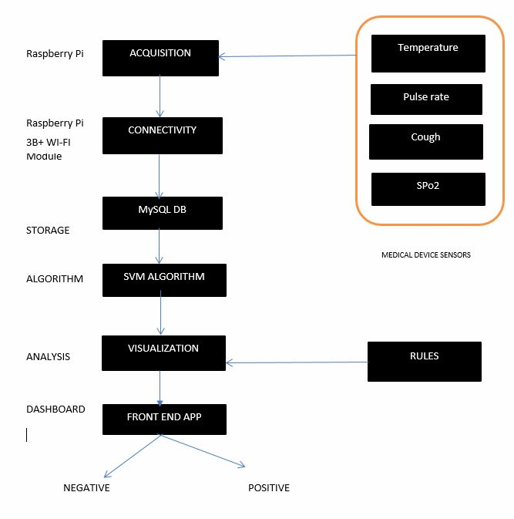
7. State Diagram/Workflow
Notes:
9

Slide 10
8. Conclusion
The COVID-19 virus has been around for almost a year now and the medical community, scientists, and researchers are trying their best to identify a cure for the disease. At the same time, people around the world are facing issues in determining the state of an individual as healthy or affected by the virus.
Considering the numerous difficulties and the associated dangers in its diagnosis, it is preferable to be able to perform the disease detection using wearable devices.
We proposed a framework for remote screening of the virus using standards based practice identified in the literature. The framework utilizes sensors combined in the form of a wearable device that can be worn by any individual to know in a few seconds whether the person is healthy or is doubtful of carrying the disease.
The framework requires testing on a large population and at the same time the data obtained through testing can be used for advanced analytics such as outbreak prediction and prevention, population segmenting, as well as helping the government and decisionmakers to take appropriate measures.
Notes:
10

Slide 11
9. Suggestion
Focus on getting the Data Set
Focus on the Software & Hardware prototype

Slide 12
9. References
Johnson, R.M.; Vinetz, J.M. Dexamethasone in the management of covid-19. BMJ 2020.
An IoT framework for Screening of Covid-19 using Real-Time Data from Wearable Sensors.
CDC (Centers for Diseases Control and Prevention). About Variants of the Virus That Causes COVID-19. Available online: https://www.cdc.gov/coronavirus/2019-ncov/transmission/variant.html (accessed on 3 April 2021).
Kario, K. et al. The first study comparing a wearable watch-type blood pressure monitor with a conventional ambulatory blood pressure monitor on in-office and out-of-office settings. J. Clin. Hypertens. 22, 135–141 (2020).
Tripathy, A.K.; Mohapatra, A.G.; Mohanty, S.P.; Kougianos, E.; Joshi, A.M.; Das, G. EasyBand: A Wearable for Safety-Aware Mobility During Pandemic Outbreak. IEEE Consum. Electron. Mag. 2020, 9, 57–61.
Yamanoor, N.S.; Yamanoor, S. Low-Cost Contact Thermometry for Screening and Monitoring during the COVID-19 Pandemic. In Proceedings of the 2020 IEEE International IOT, Electronics and Mechatronics Conference (IEMTRONICS), Vancouver, BC, Canada, 9–12 September 2020; pp. 1–6.
Zhu, Y.; Chen, L.; Ji, H.; Xi, M.; Fang, Y.; Li, Y. The risk and prevention of novel coronavirus pneumonia infections among inpatients in psychiatric hospitals. Neurosci. Bull. 2020, 36, 299–302.
Tahamtan, A.; Ardebili, A. Real-time RT-PCR in COVID-19 detection: Issues affecting the results. Expert Rev. Mol. Diagn. 2020, 20, 453–454.
Notes:
12

Slide 13
Thank You...!!
Notes:
13

